Slide 1


Music Trend
Team 1
Aidan McMurry
Amos Fung
An Bui
Shadi Askarzadeh
Jan 2020

Slide 2
Introduction
Aidan
Why Music?
Universal
Good pool of data
Major industry with Billions of revenues
Our Study
Audio features for different countries utilizing the top 50 songs.
Generate comparison between features and countries.

Slide 3
Study Plan
Amos
Data Collection
Spotify API
Statistical Analysis
Person correlation coefficient
Mean and frequency comparison
Analytics results
Audio features comparison with the global
Audio features mean and frequency comparison between countries.
Two-way T test Analysis

Slide 4
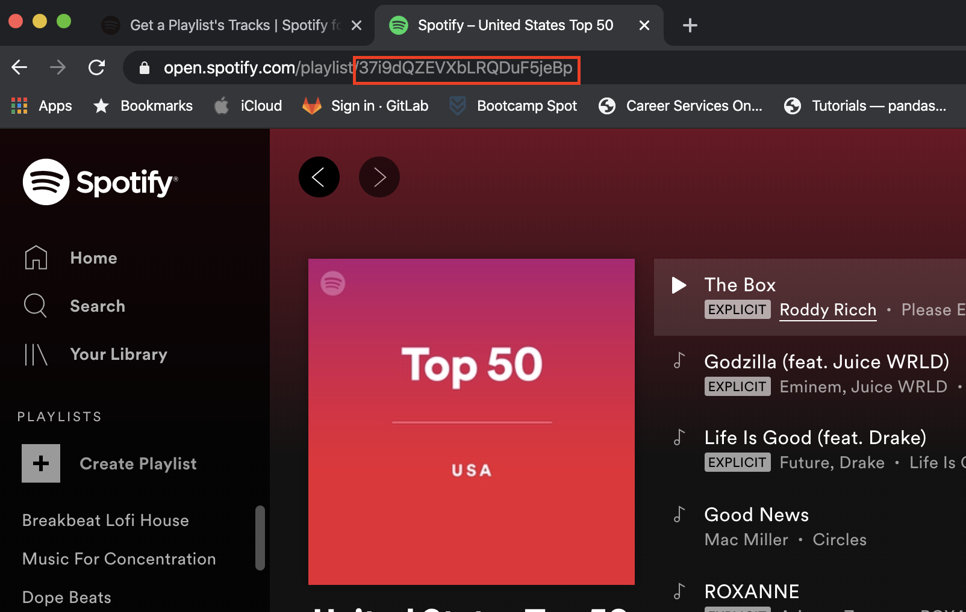
SPOTIFY API
Amos
Spotify conveniently maintains top 50 playlists by popularity for many regions
Uses Oauth 2.0 for authentication, handled by Spotipy package
All data pulled on Saturday, January 18th

Slide 5
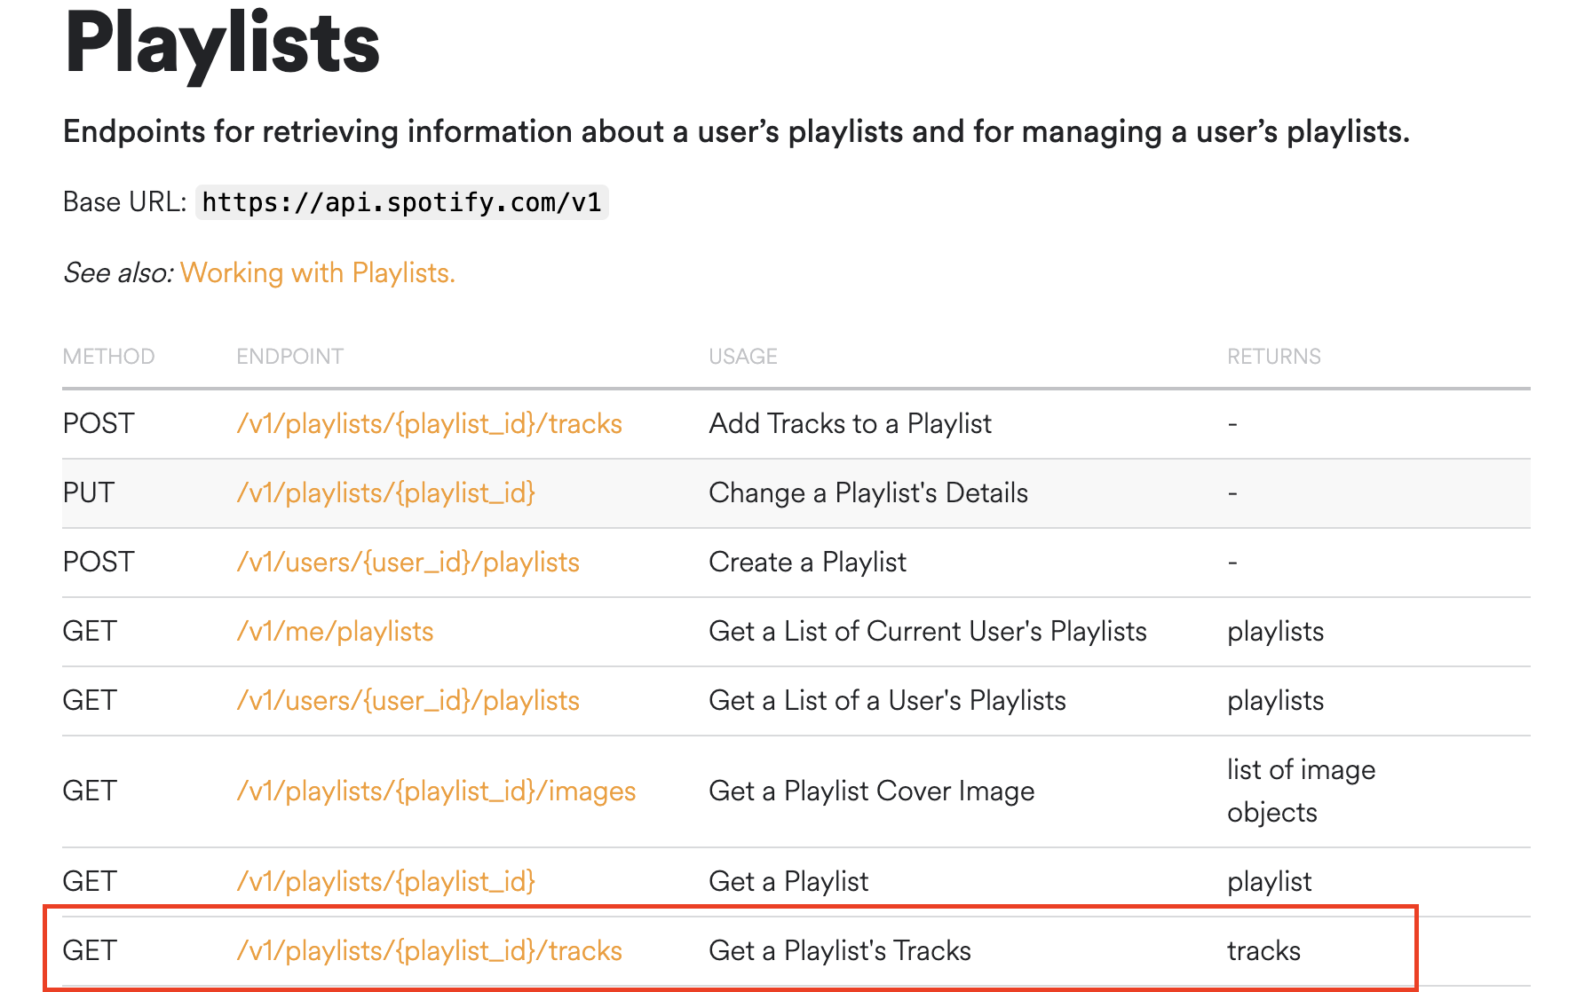
Amos

Slide 6
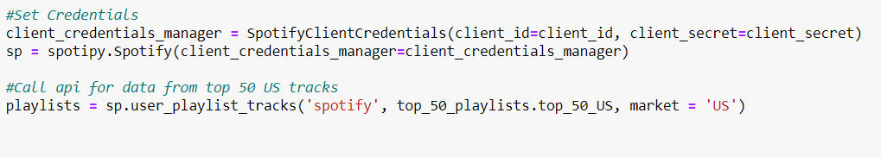
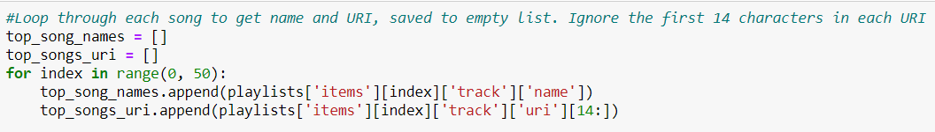
API CALLING
Amos

Slide 7
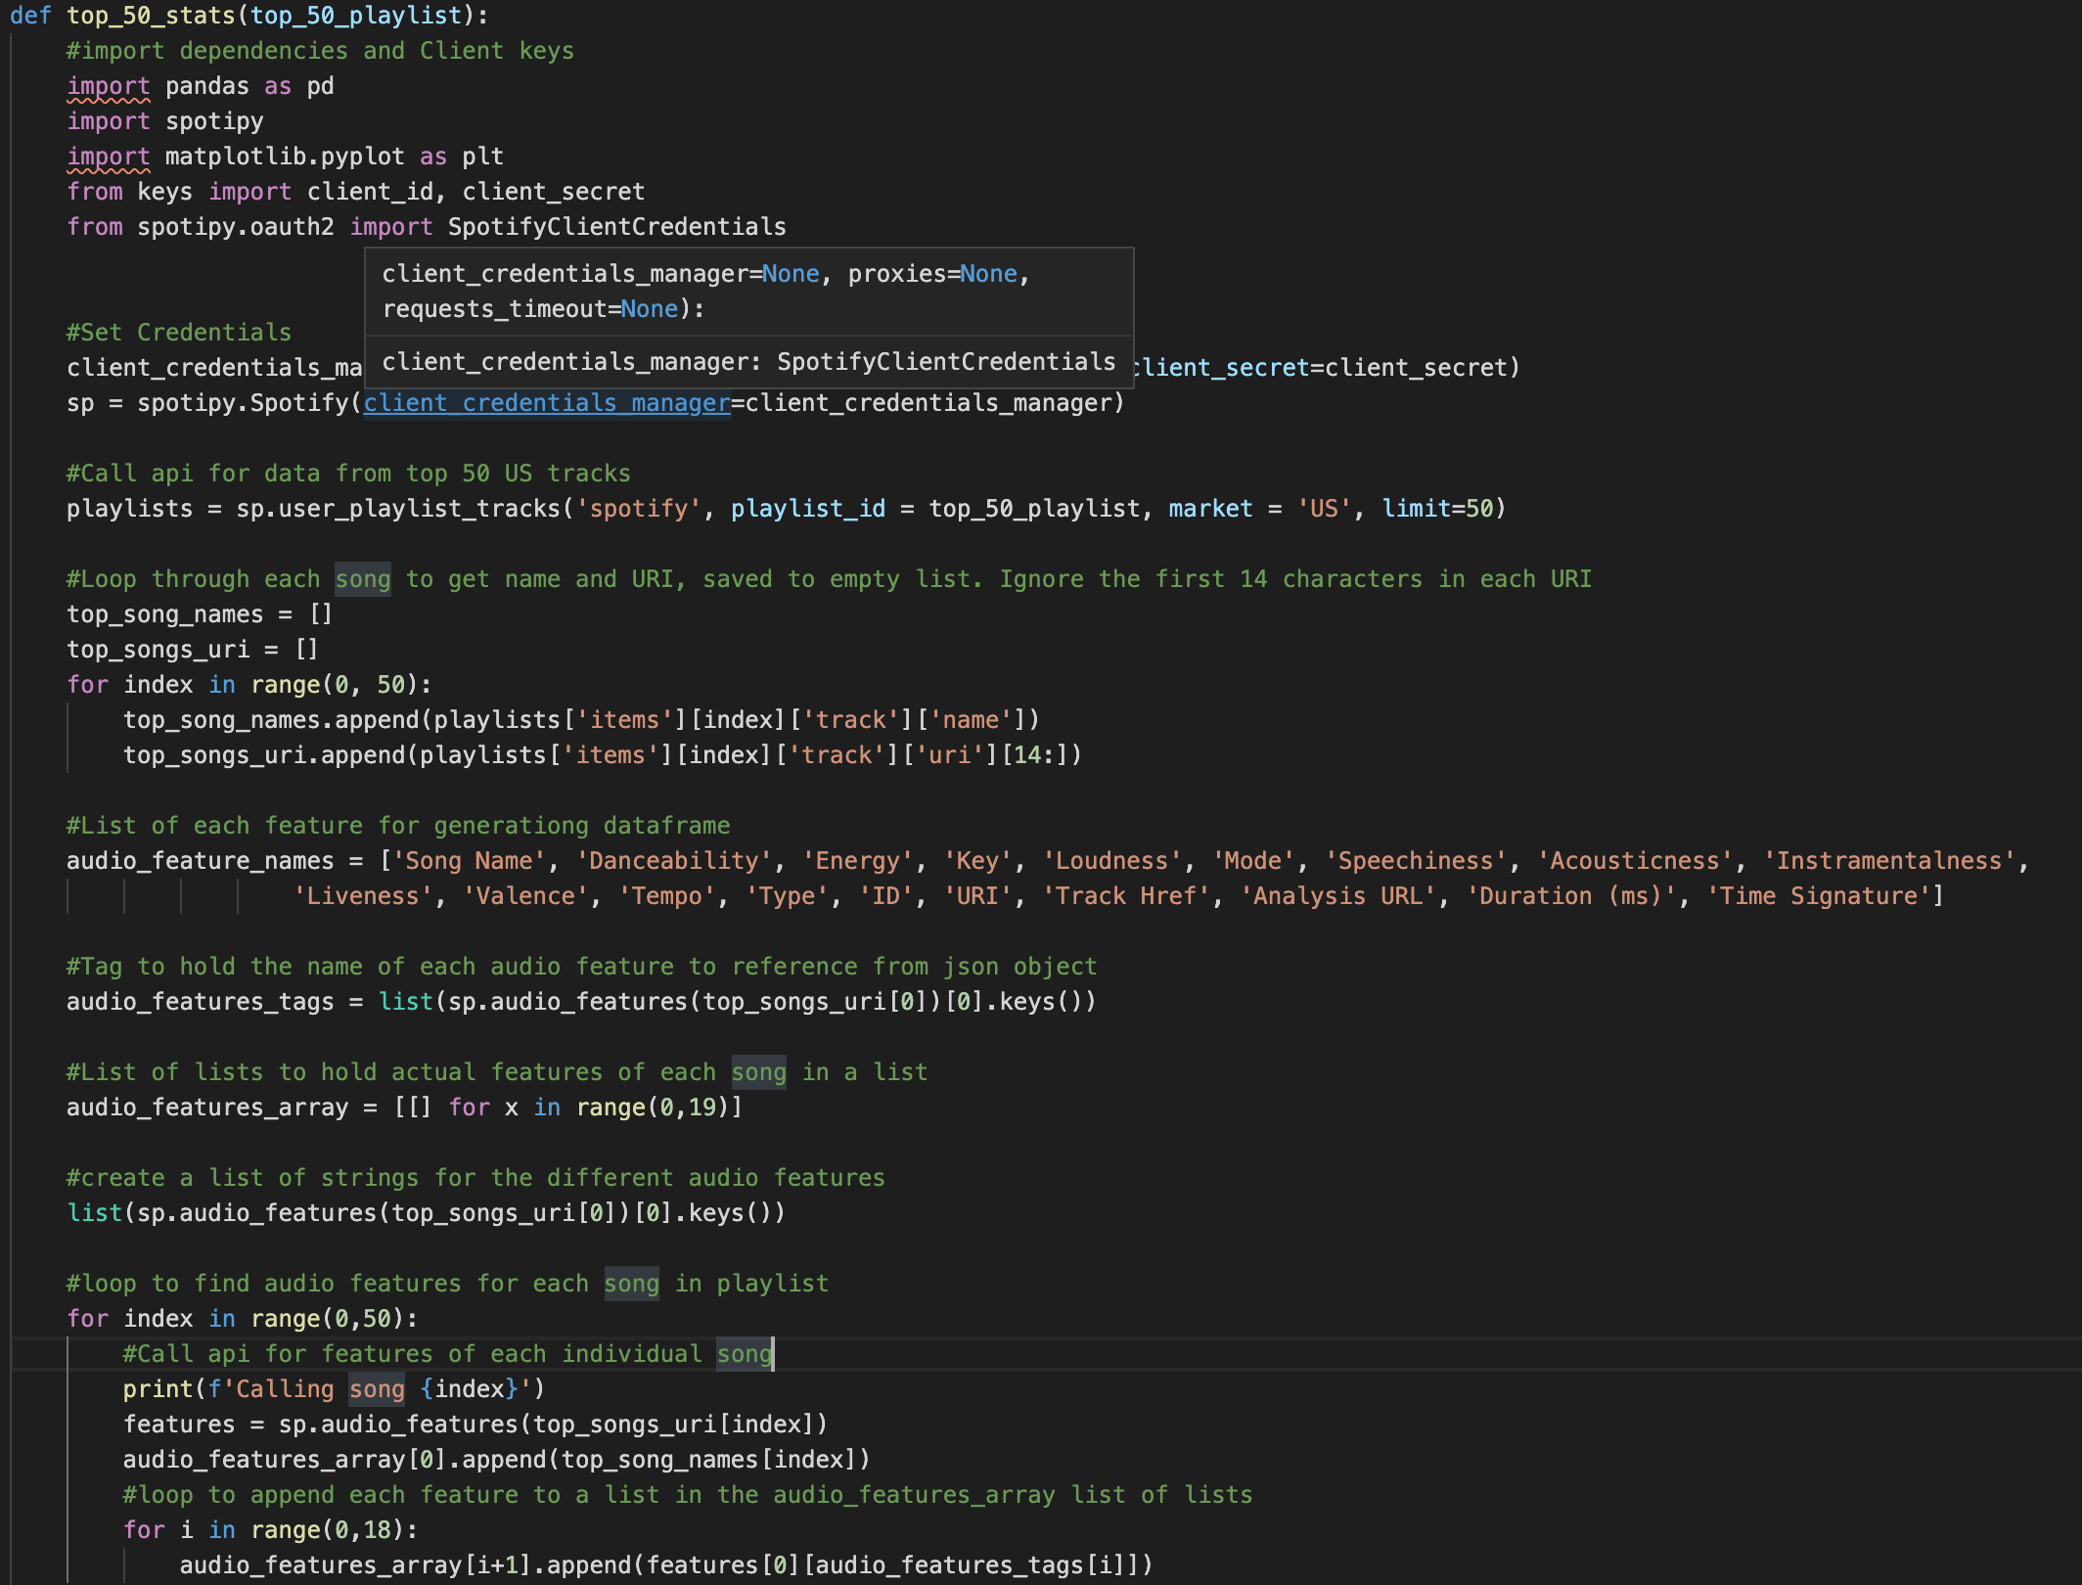
Amos

Slide 8
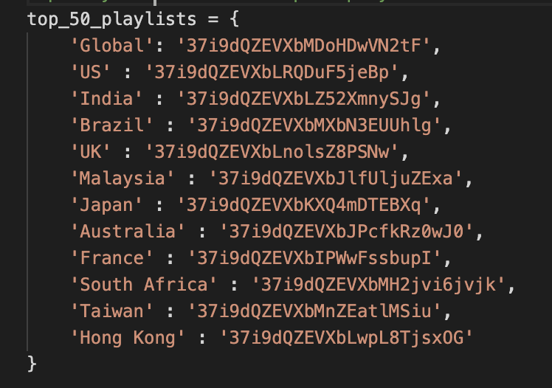
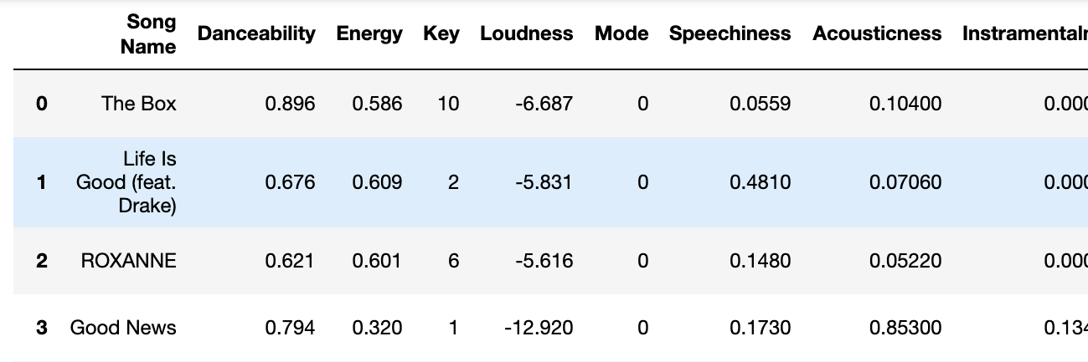
Amos
Loop through dictionary of Country: Spotify ID
Generate dataframe of audio features for top 50 songs in each country

Slide 9
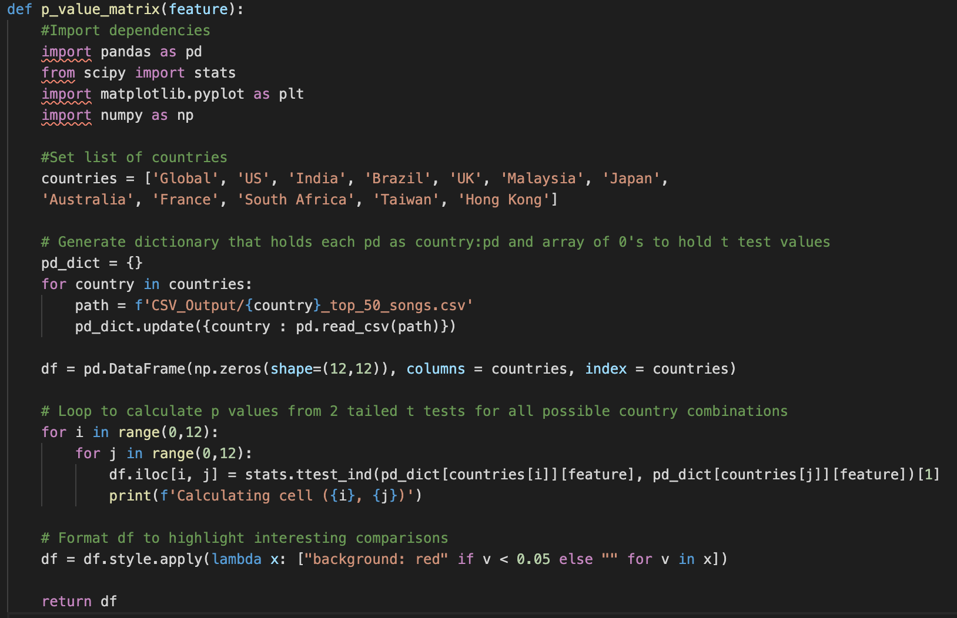
P-Value Calculation
Amos
Need to add codes and the results

Slide 10
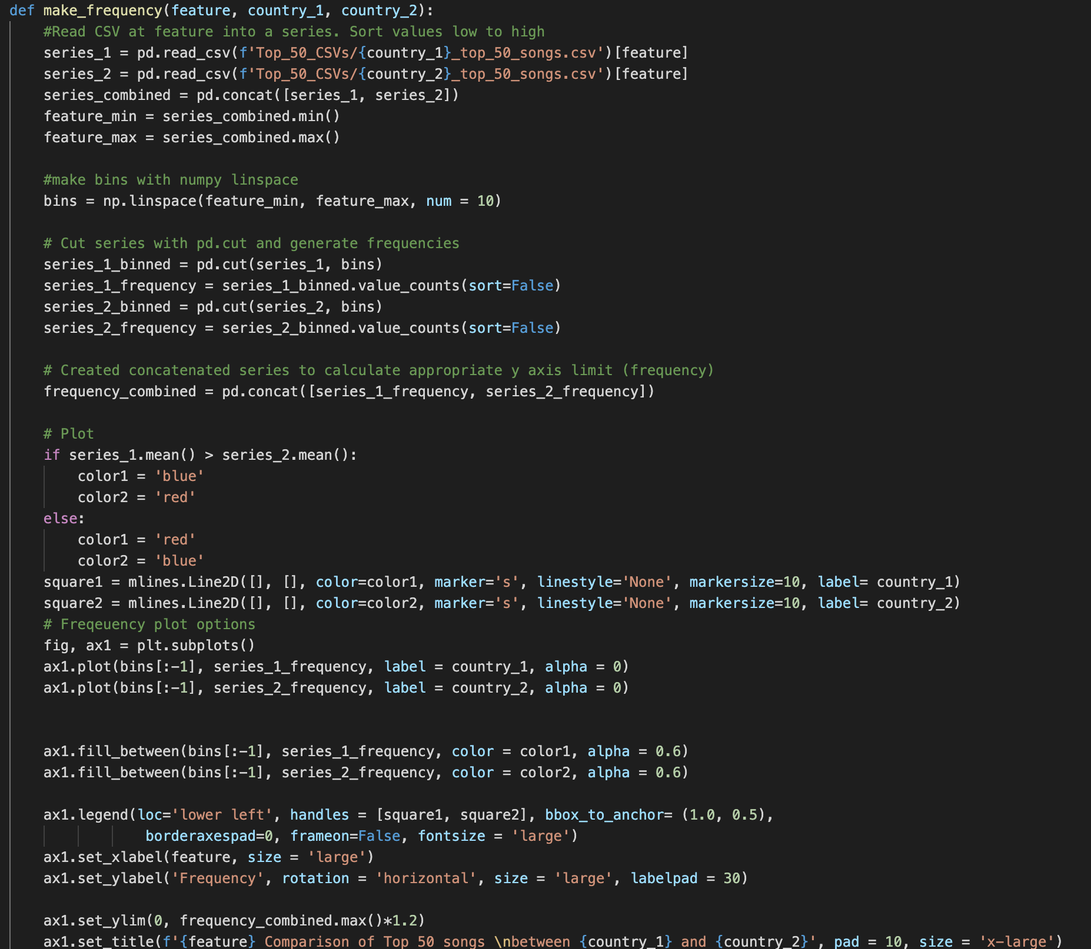
Amos

Slide 11
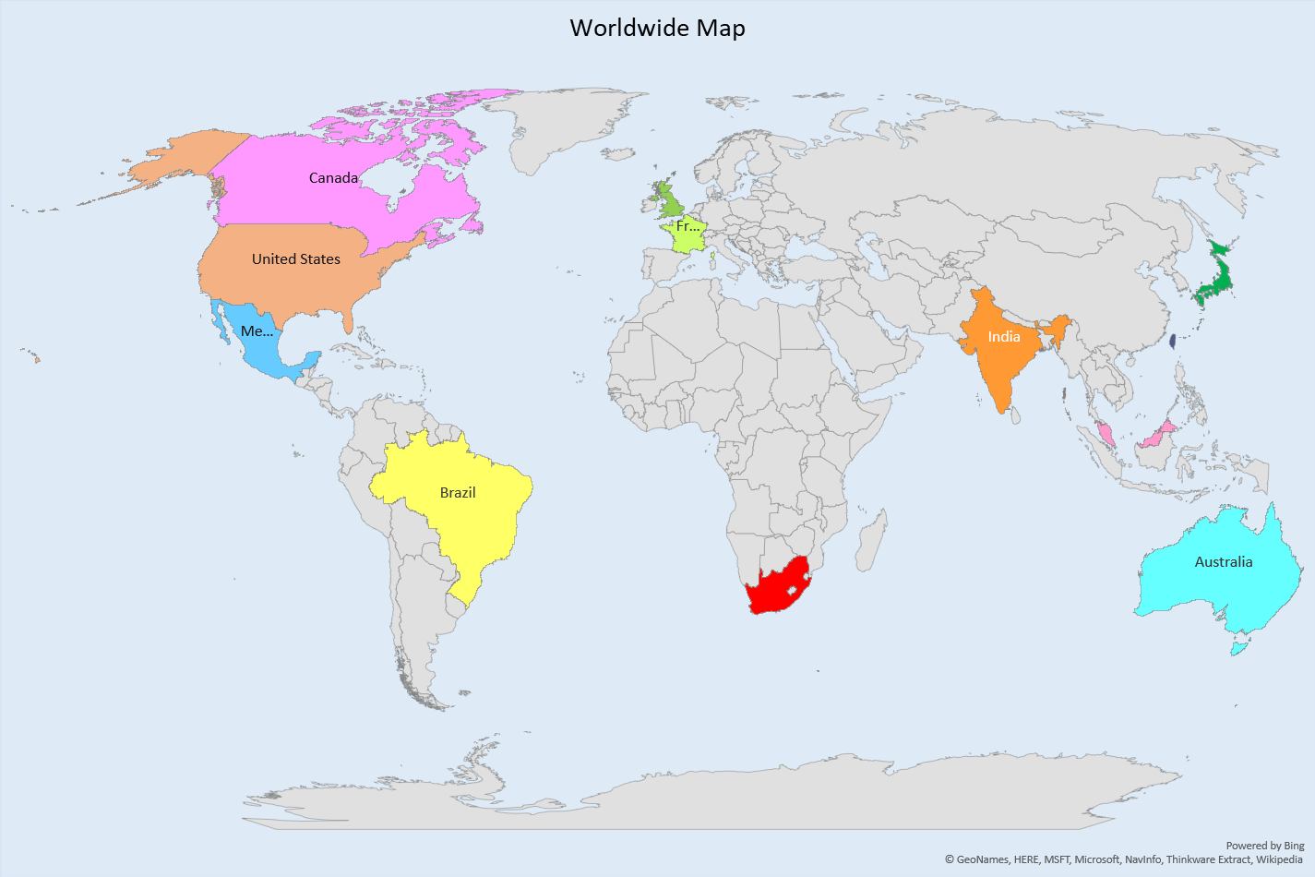
Data Selection
Amos or Shadi…
Don’t remember who did we assign this to
Countries: 11 countries
India, UK, USA, Brazil, Japan, Malaysia, Australia, France, South Africa, Taiwan, Hong Kong, Global
Audio Features
13 elements from Spotify
Loudness
Energy
Mode
Tempo
Key
Danceability
Speechiness
Acousticness
Instramentalness
Liveness
Valence
Duration
Time Signature

Slide 12
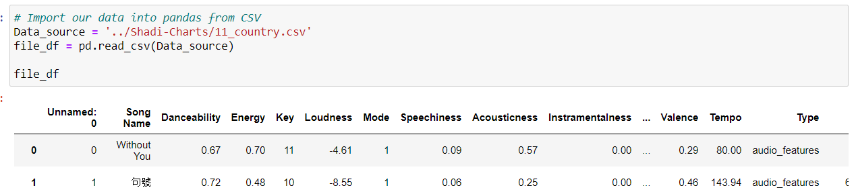
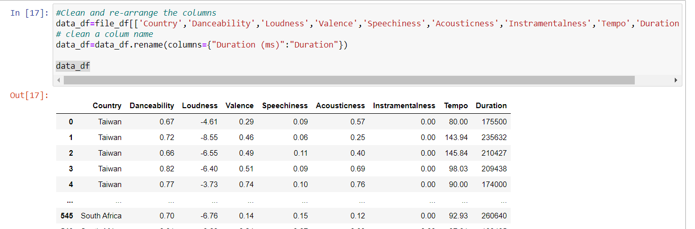
Code: Audio Features Correlation
Shadi

Slide 13
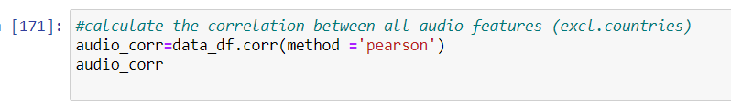
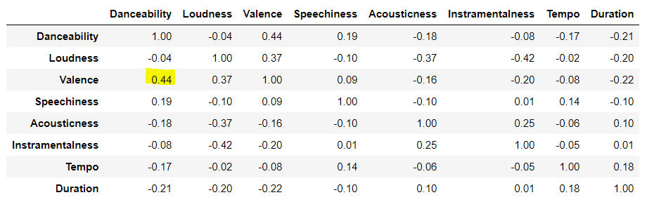
Audio Features Correlation Code
Shadi

Slide 14
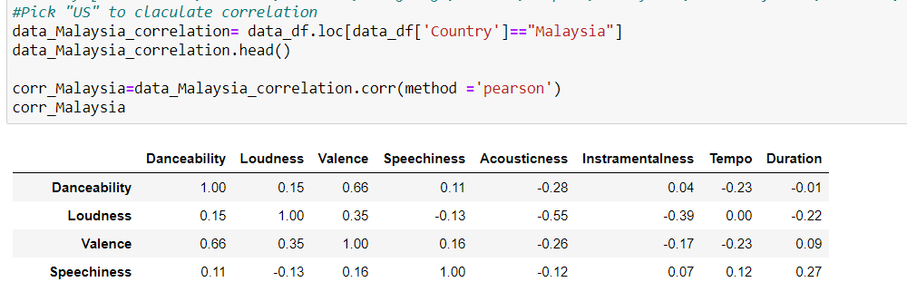
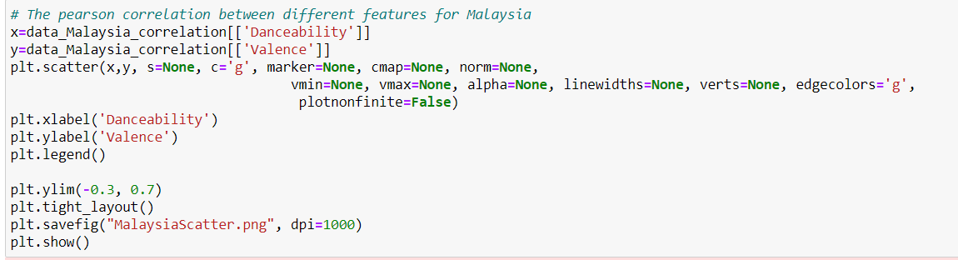
Code: Correlation at country level and scatter plot
Shadi

Slide 15

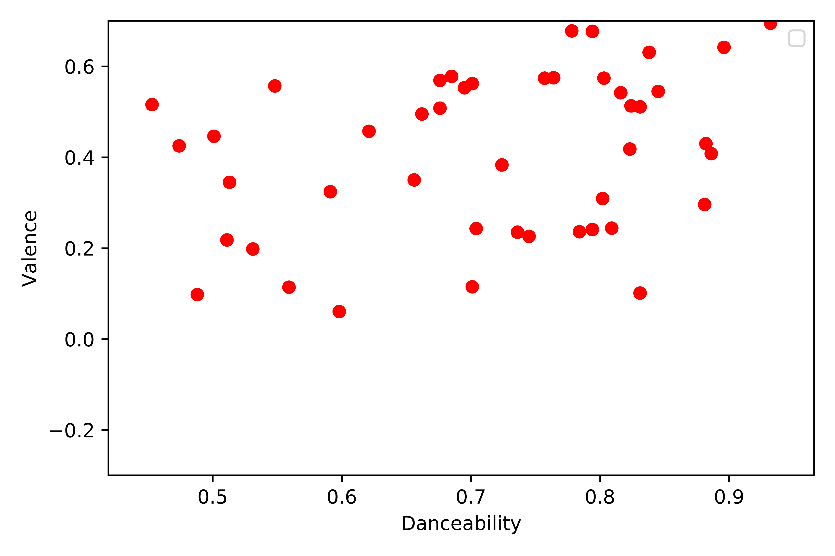

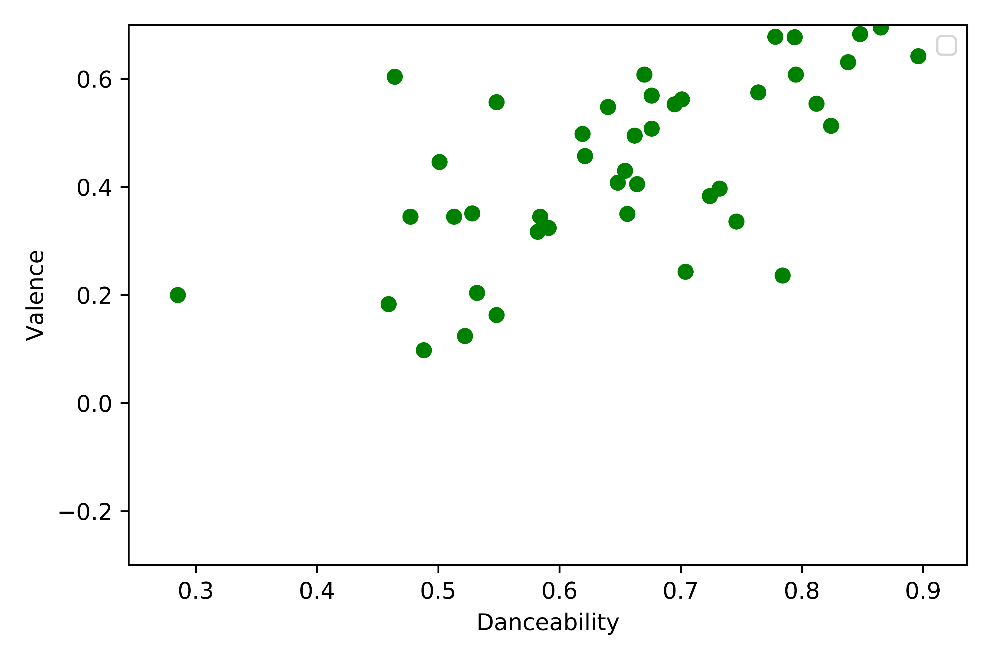
Shadi
Danceability valence correlation
Countries | Danceability and Valence
US | 0.35
Australia | 0.51
Brazil | 0.60
France | 0.36
Hong Kong | 0.55
India | 0.43
Japan | 0.63
Malaysia | 0.66
South Africa | 0.40
Taiwan | 0.57
UK | 0.46

Slide 16
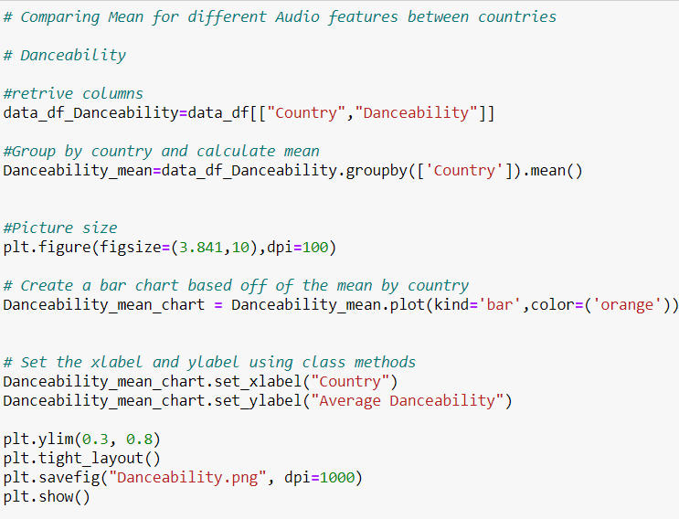

Codes: Bar & Frequency charts

Slide 17
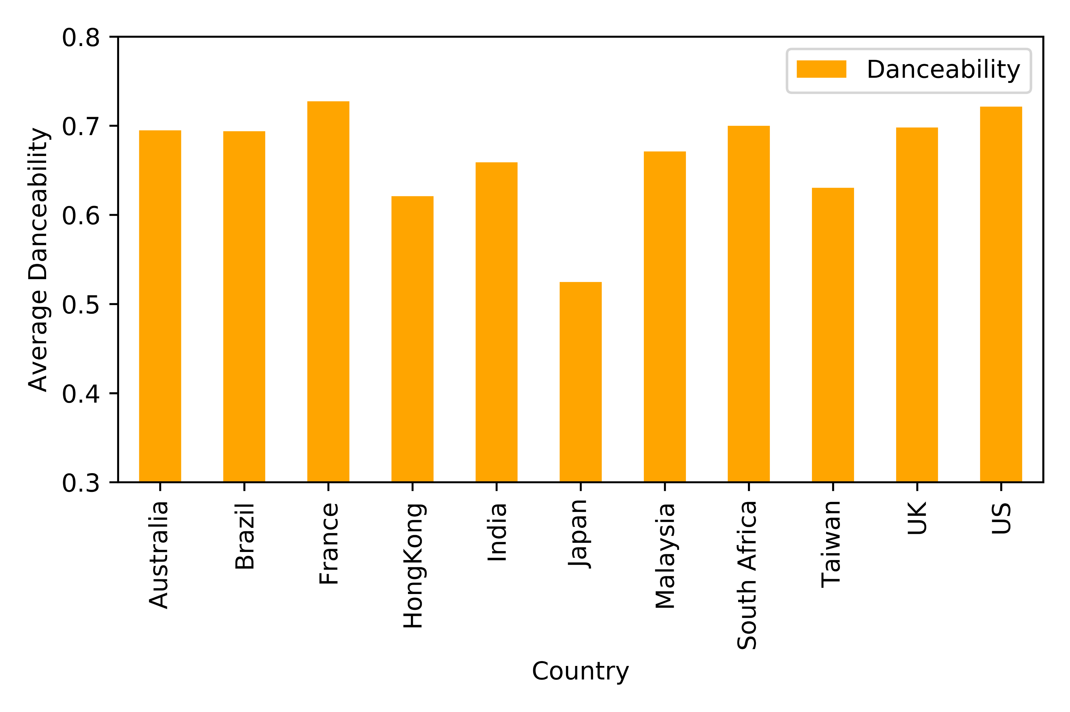
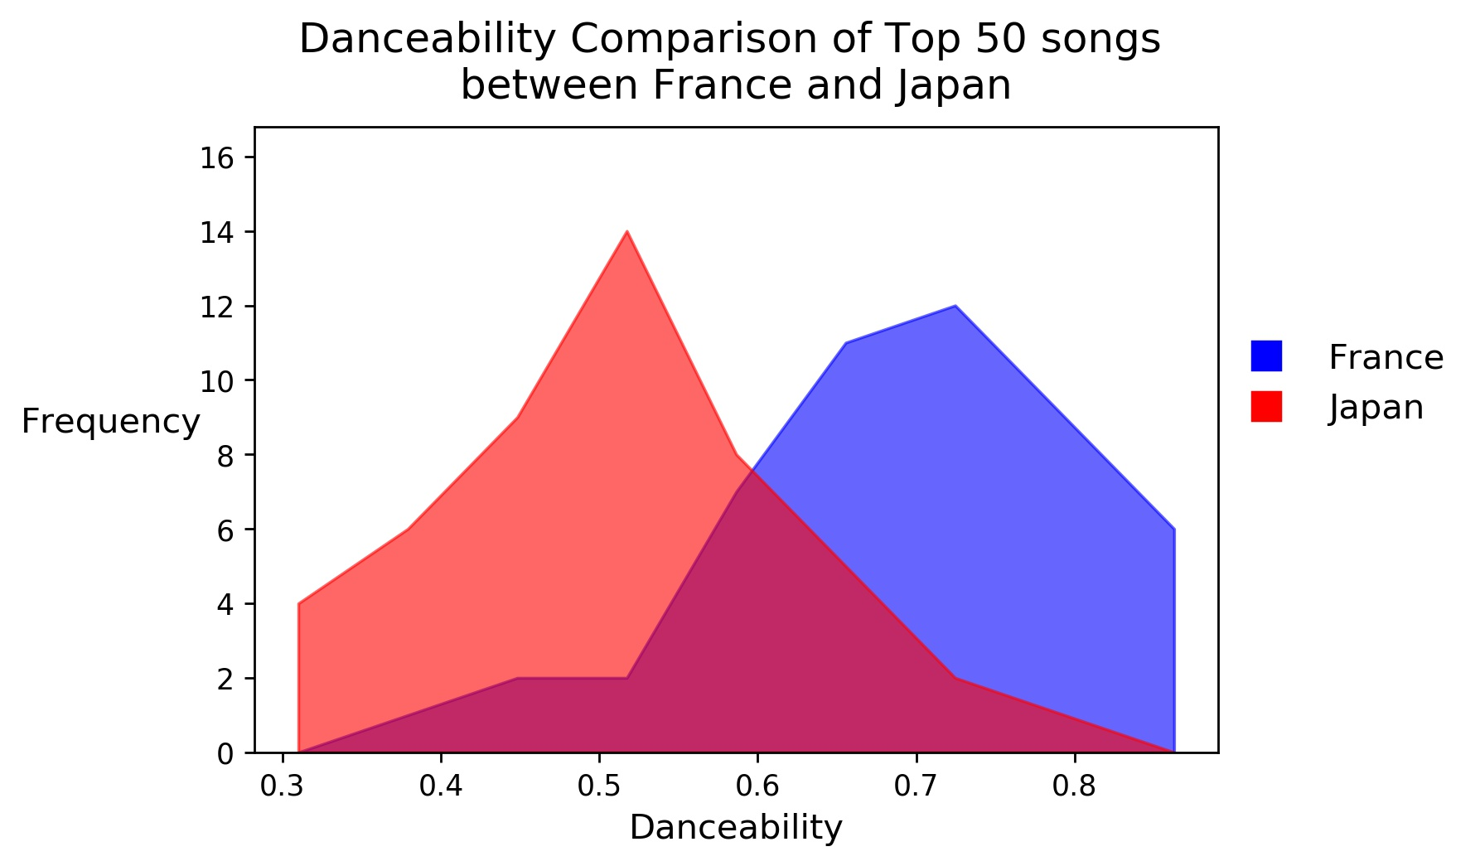
Danceability
Shadi
How suitable a track is for dancing based on tempo, rhythm stability, beat strength, and overall regularity
Notes:
The frequency plot, the blue is the one with higher mean…population frequency between two countries with greatest danceability

Slide 18
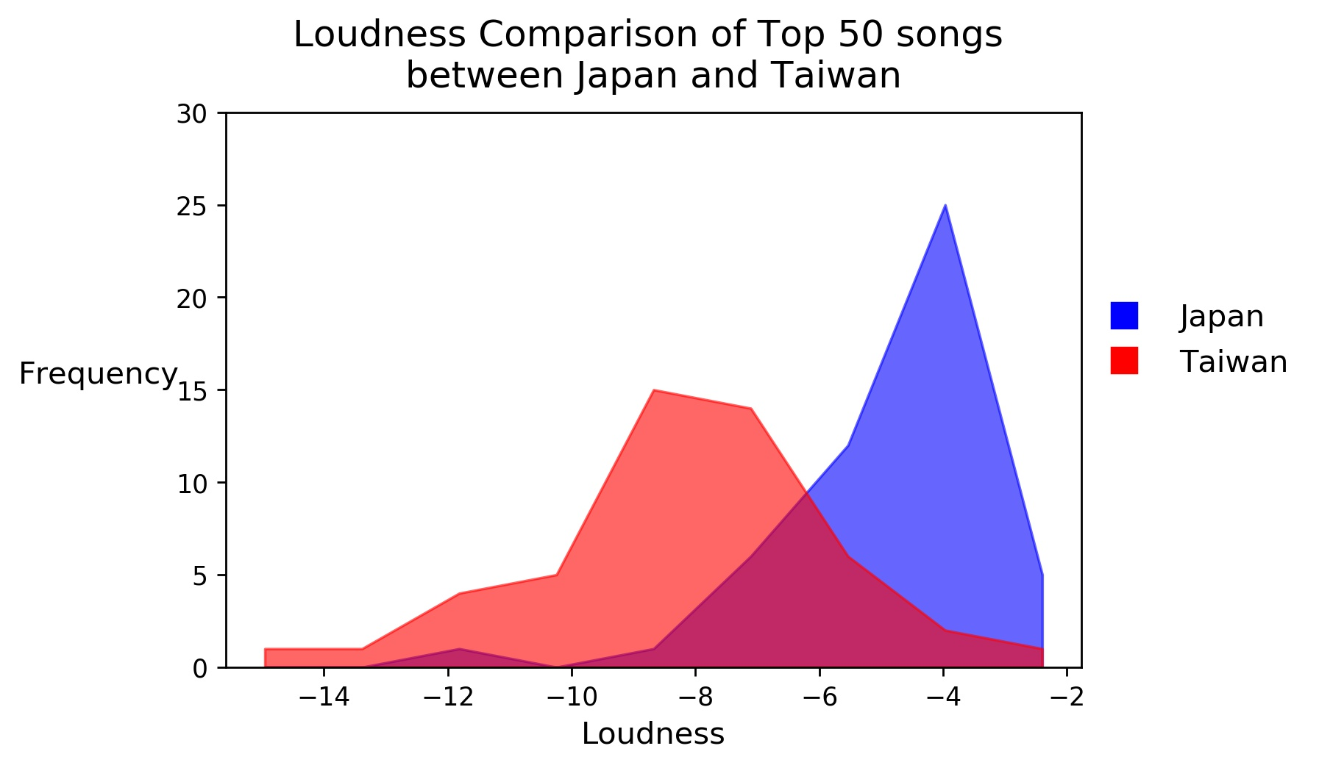
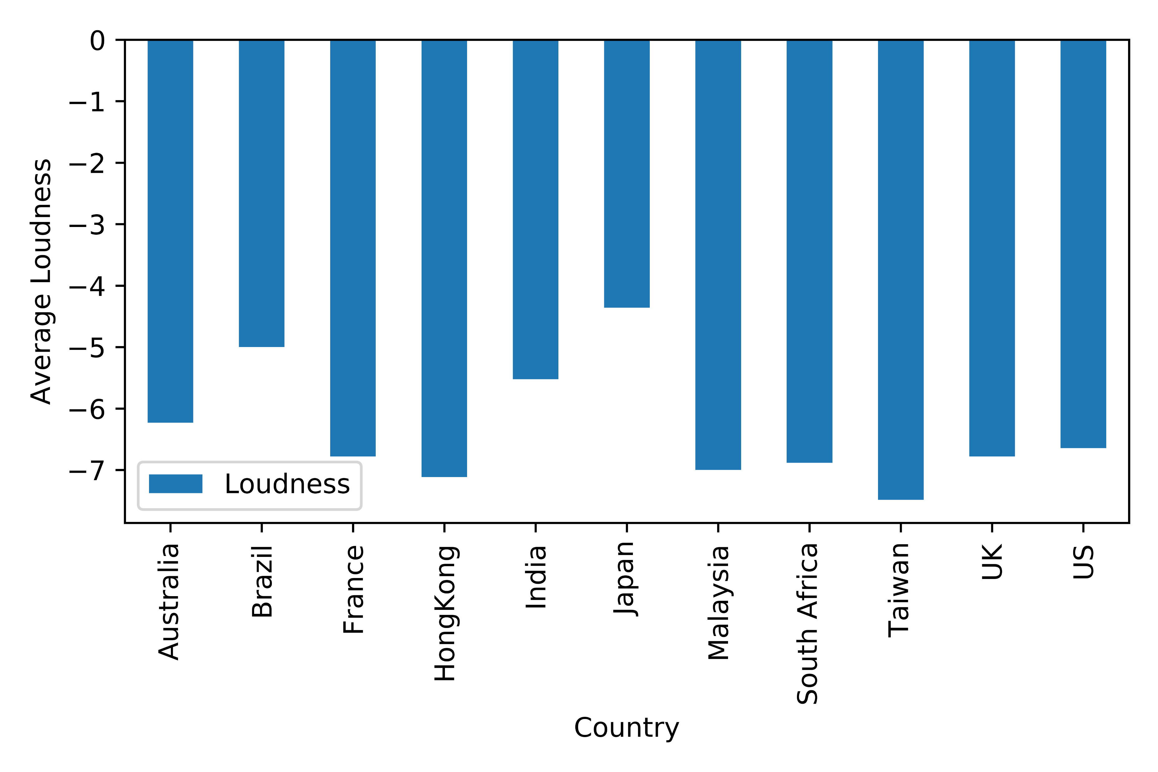
Loudness
Shadi
The overall loudness of a track in decibels (dB).

Slide 19
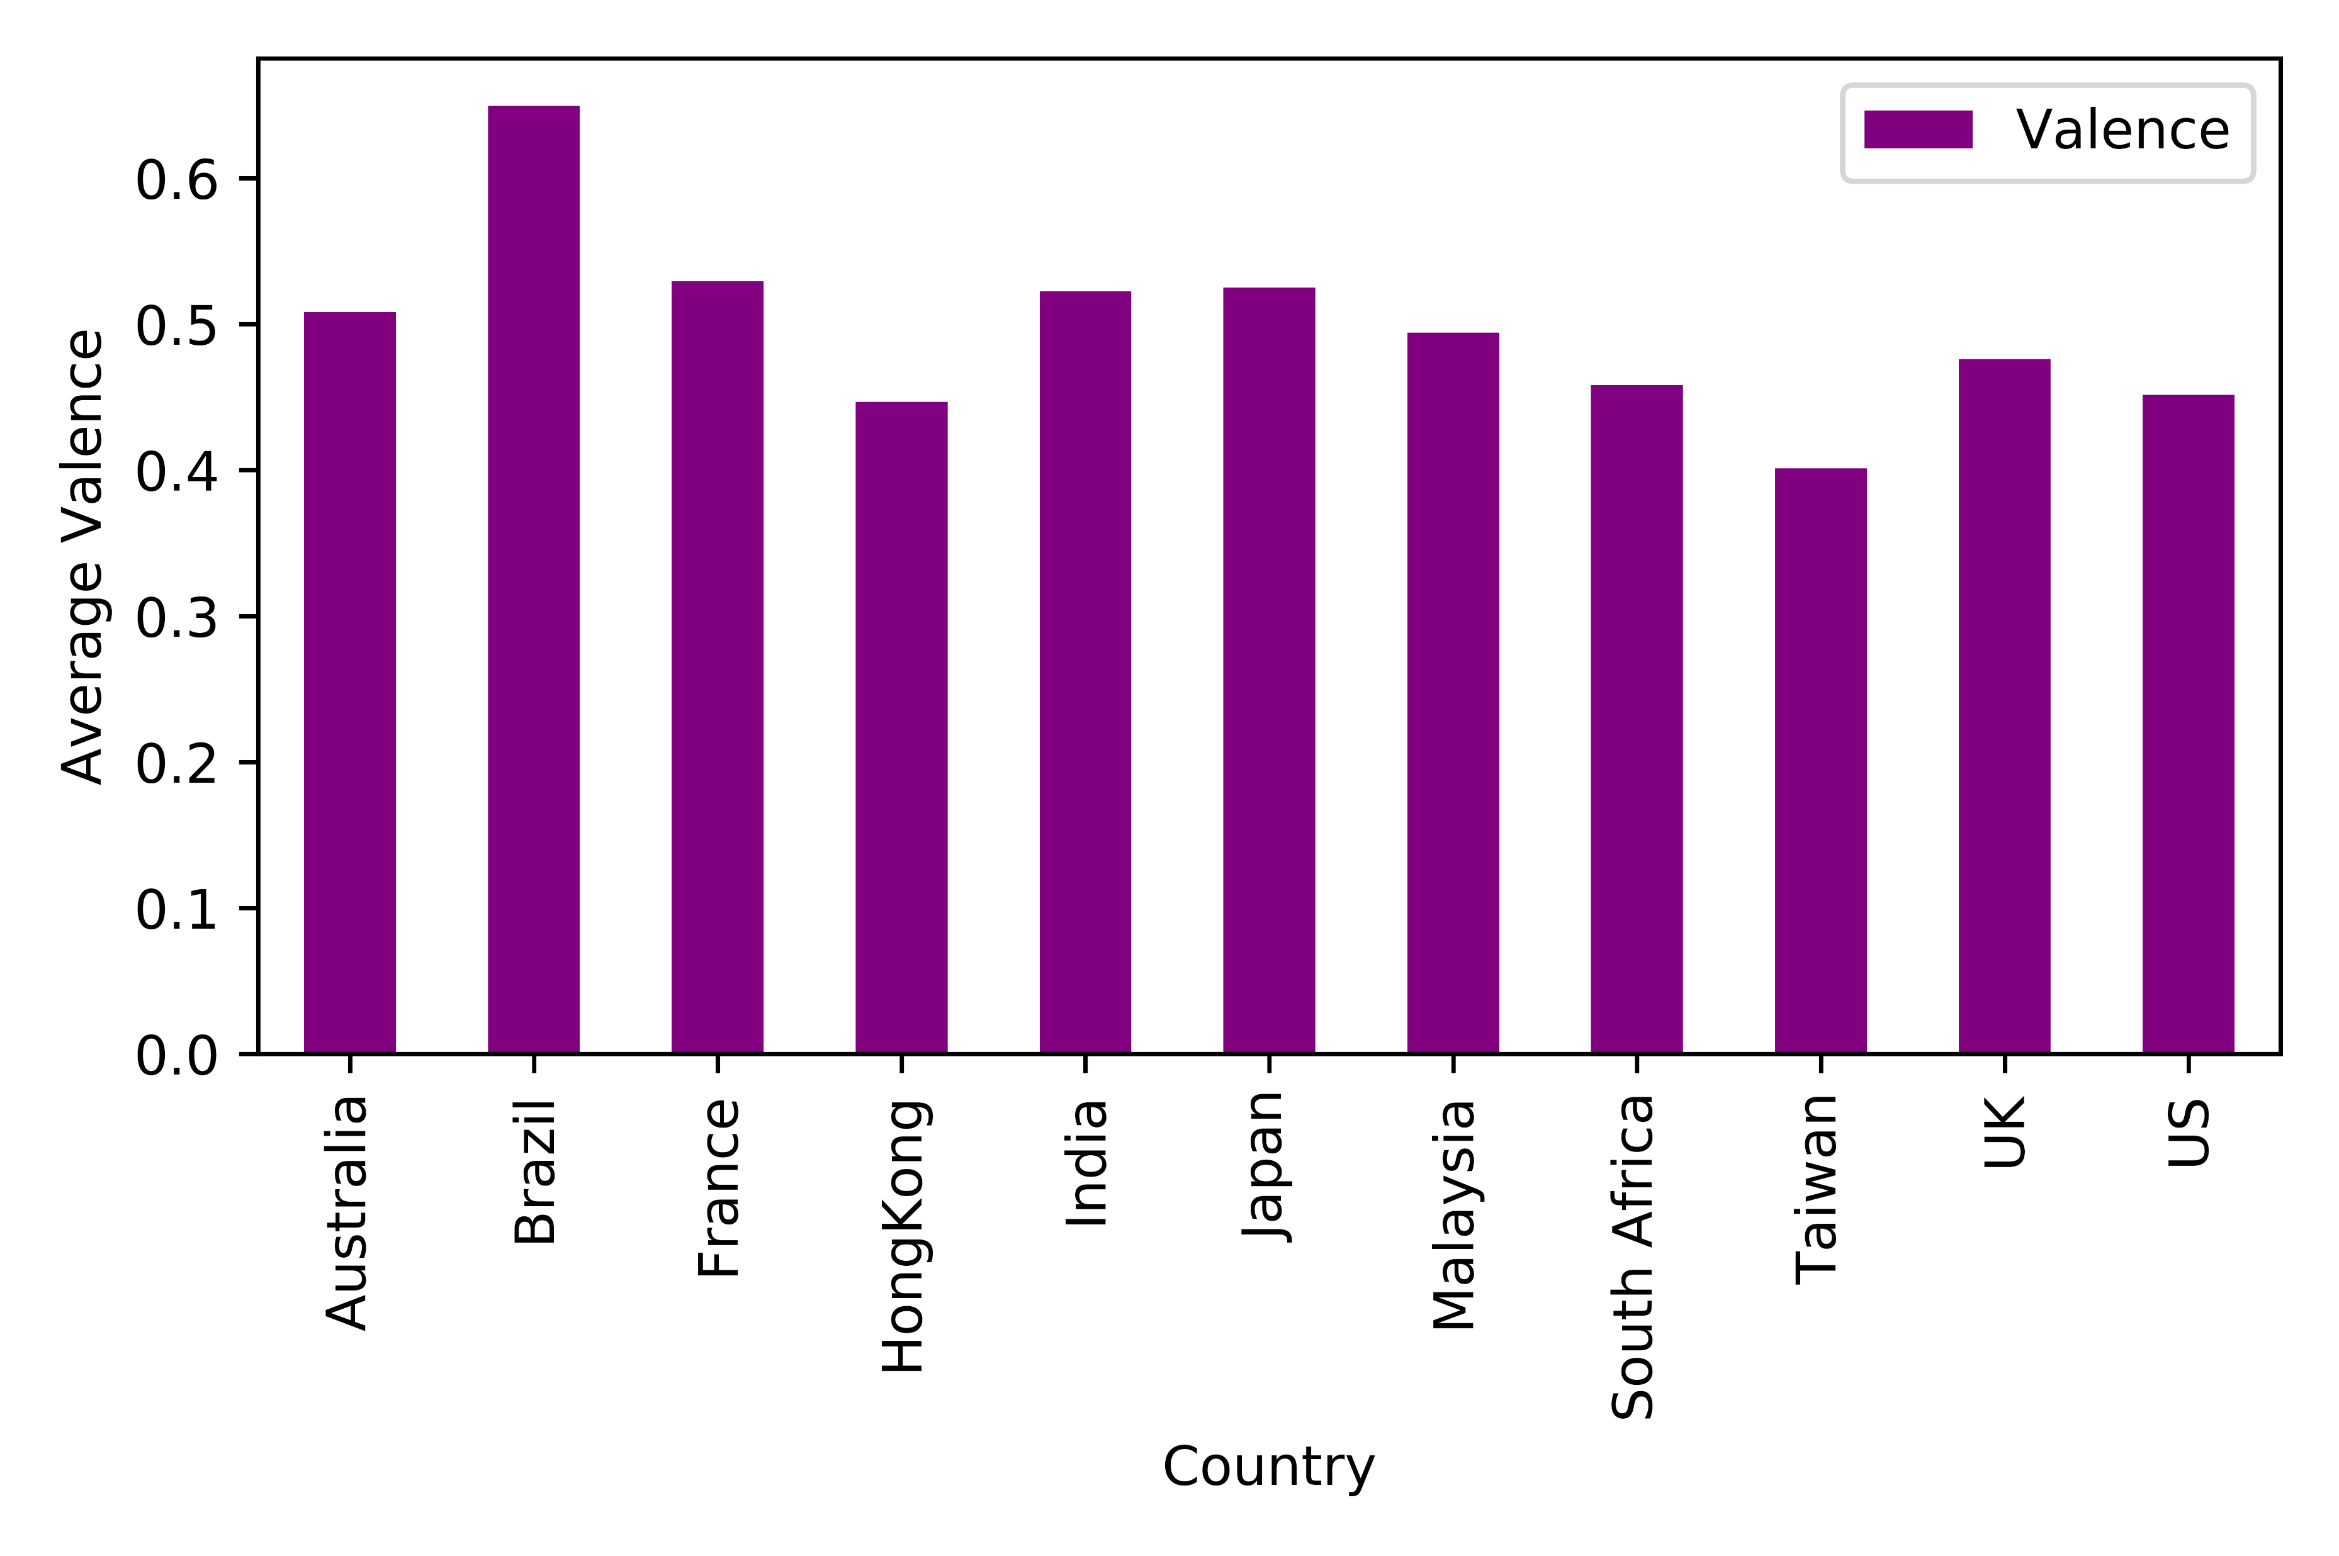
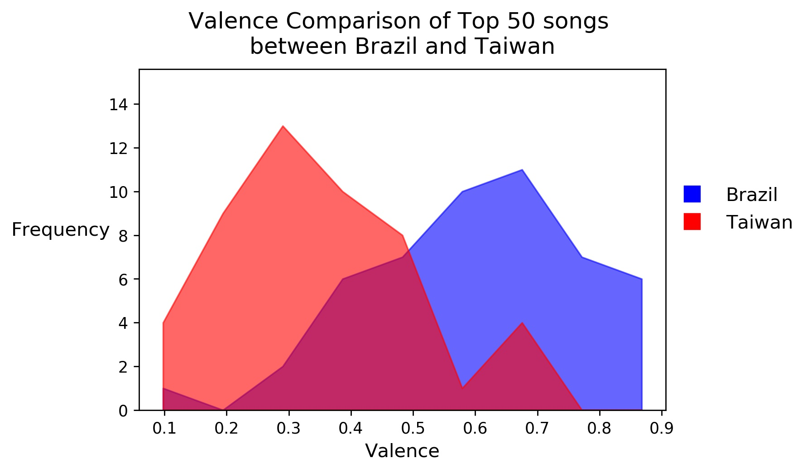
Valence
Shadi
A measure from 0.0 to 1.0 describing the musical positiveness conveyed by a track

Slide 20
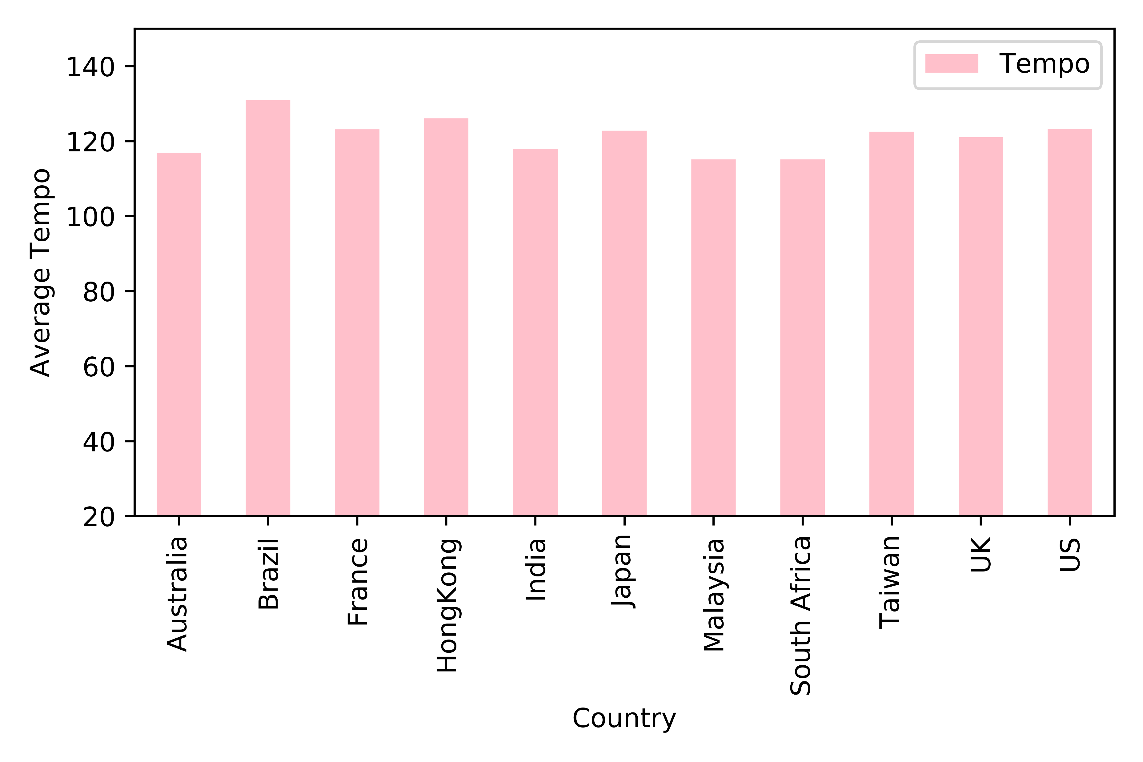
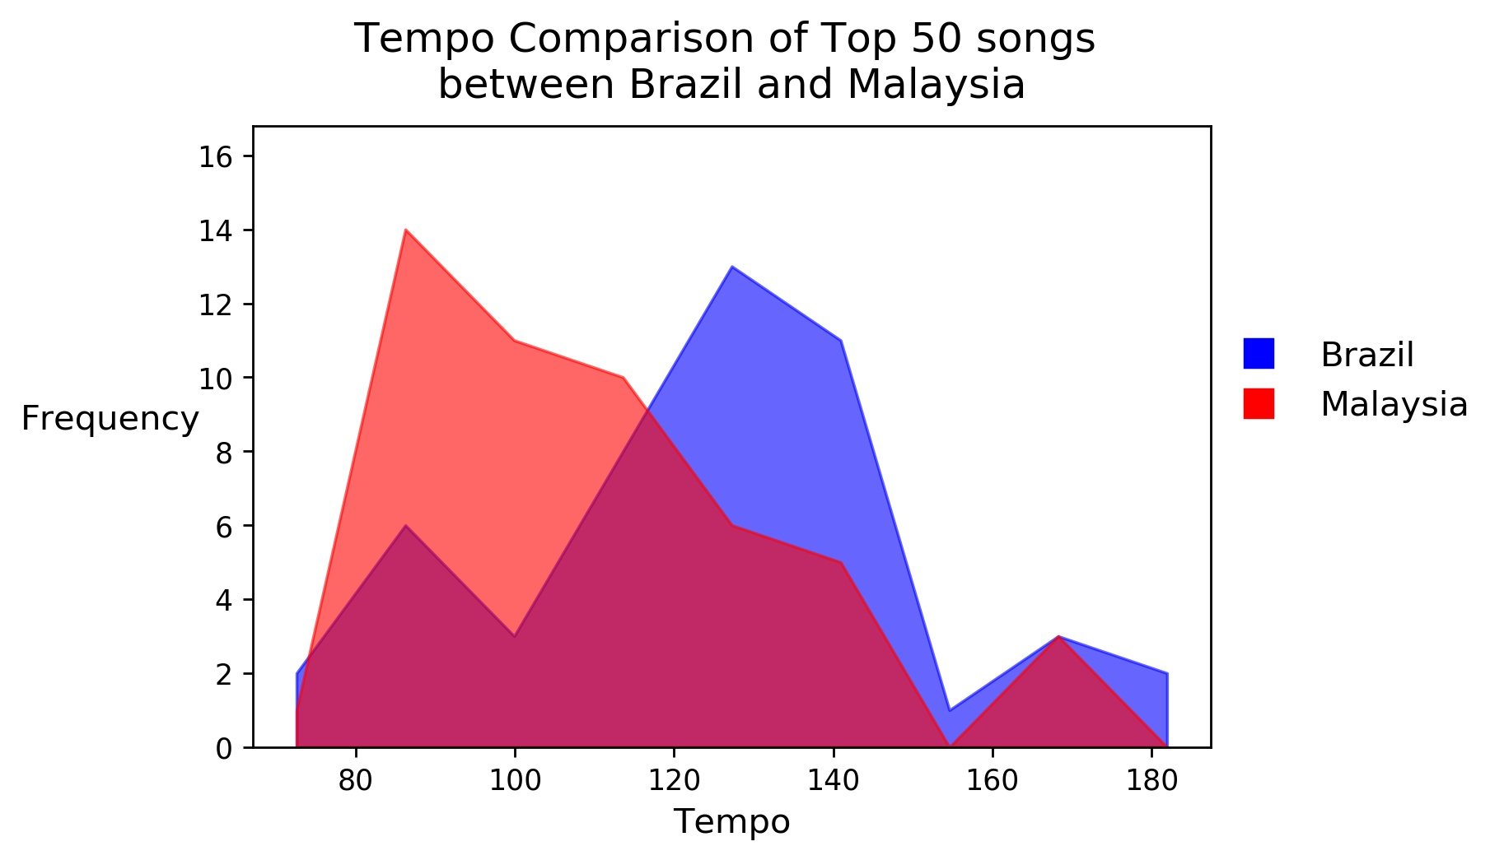
Tempo
Aidan
Tempo is the speed or pace of a given piece and derives directly from the average beat duration.

Slide 21
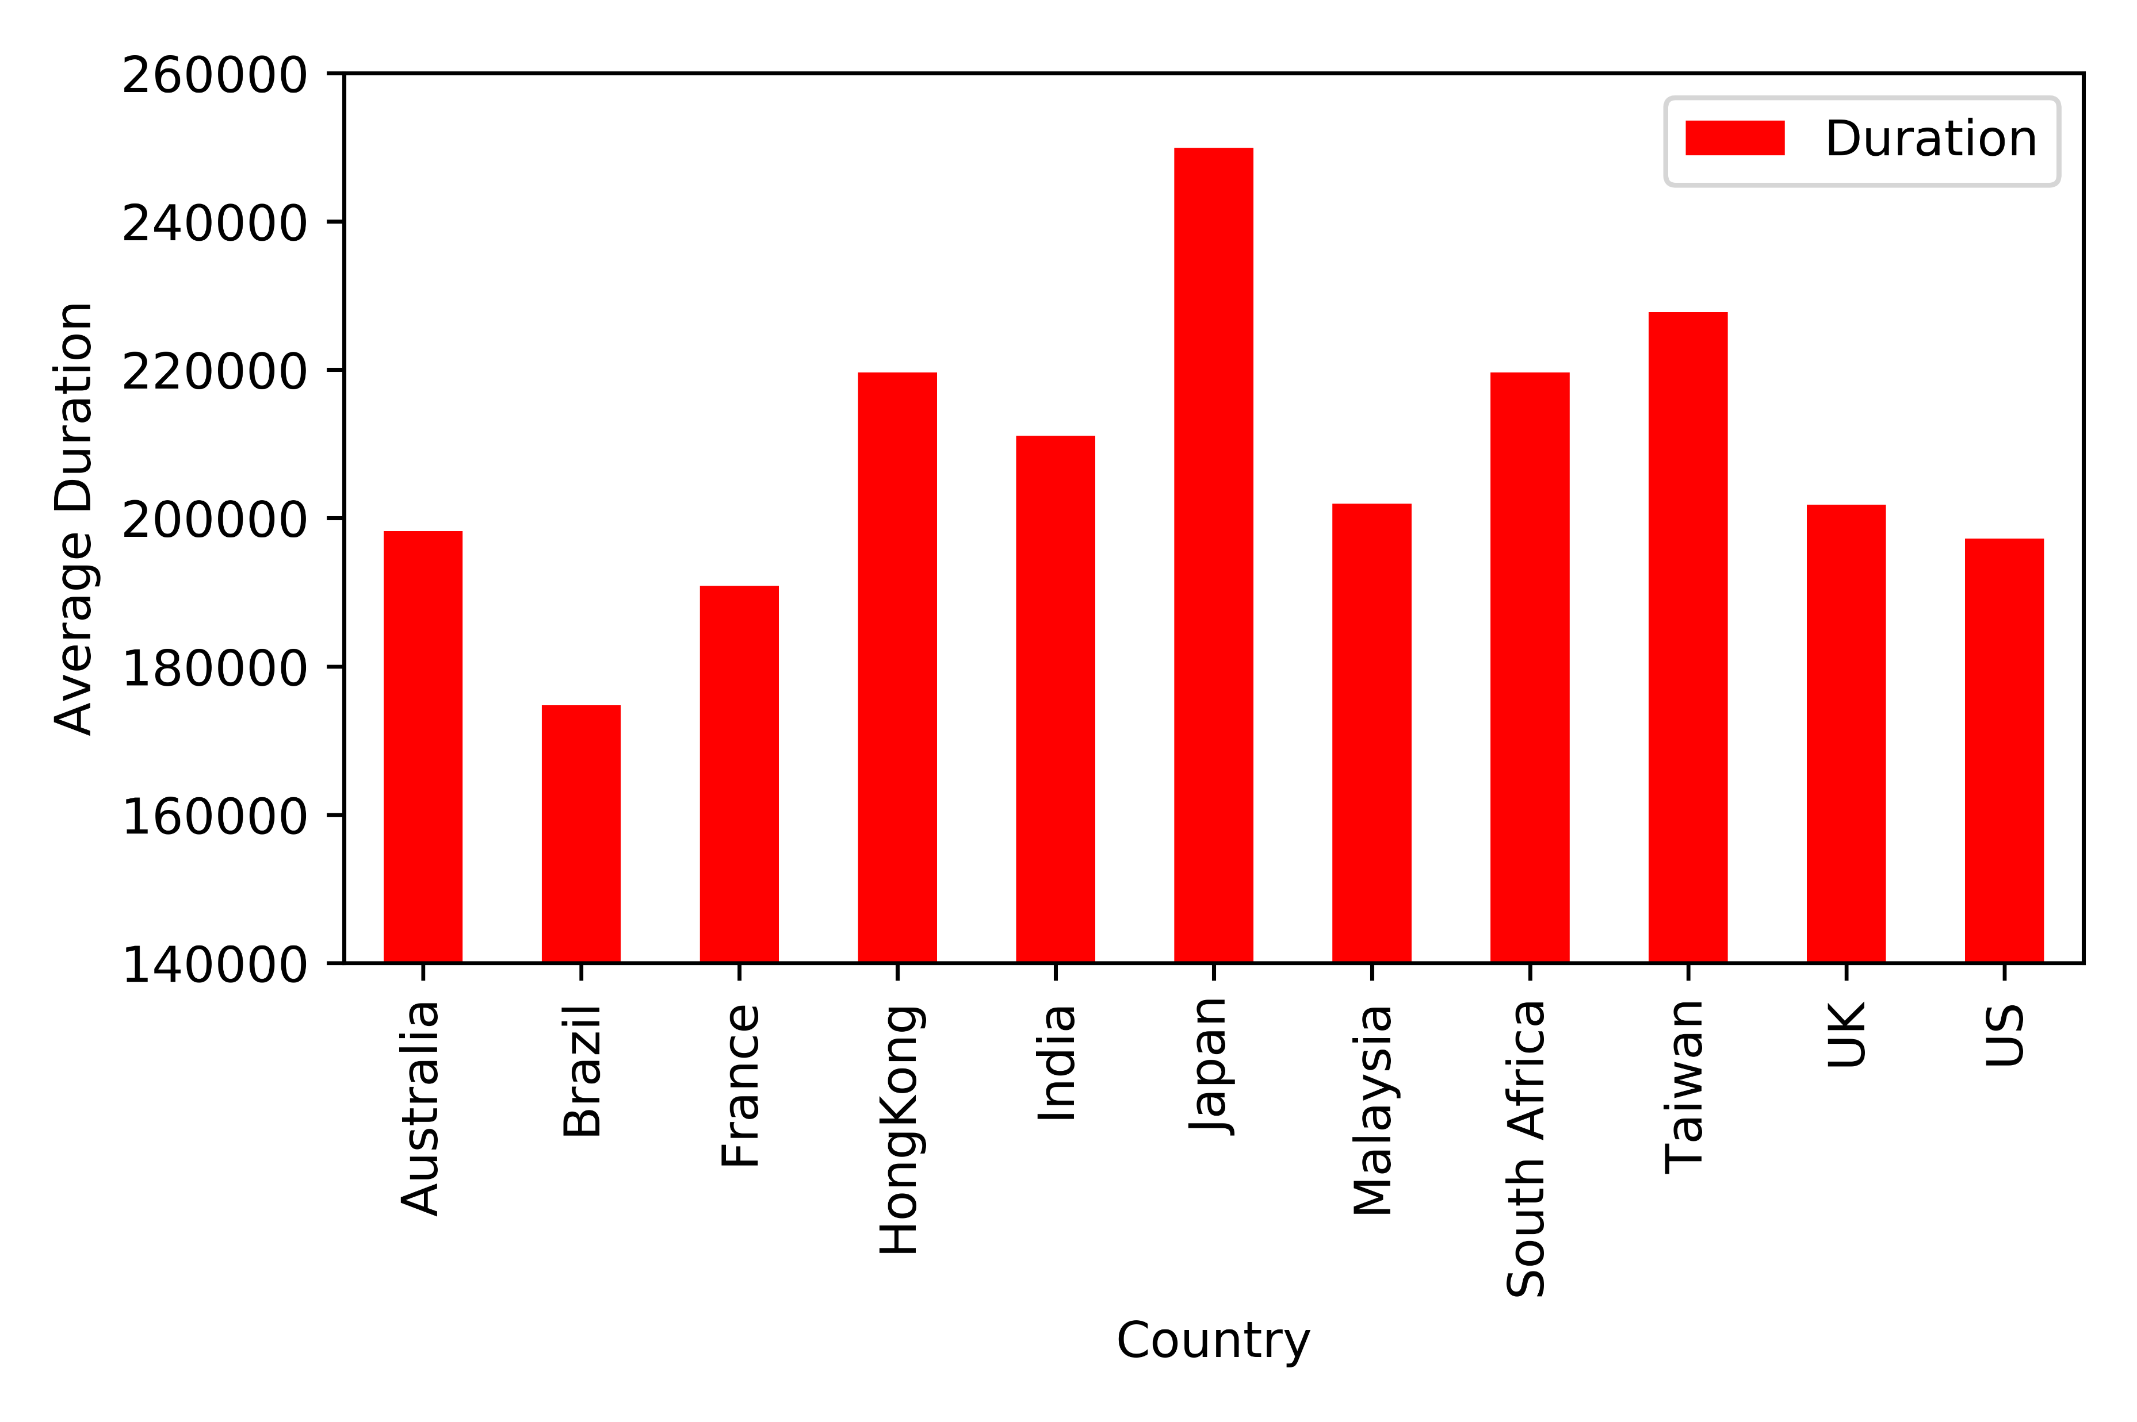
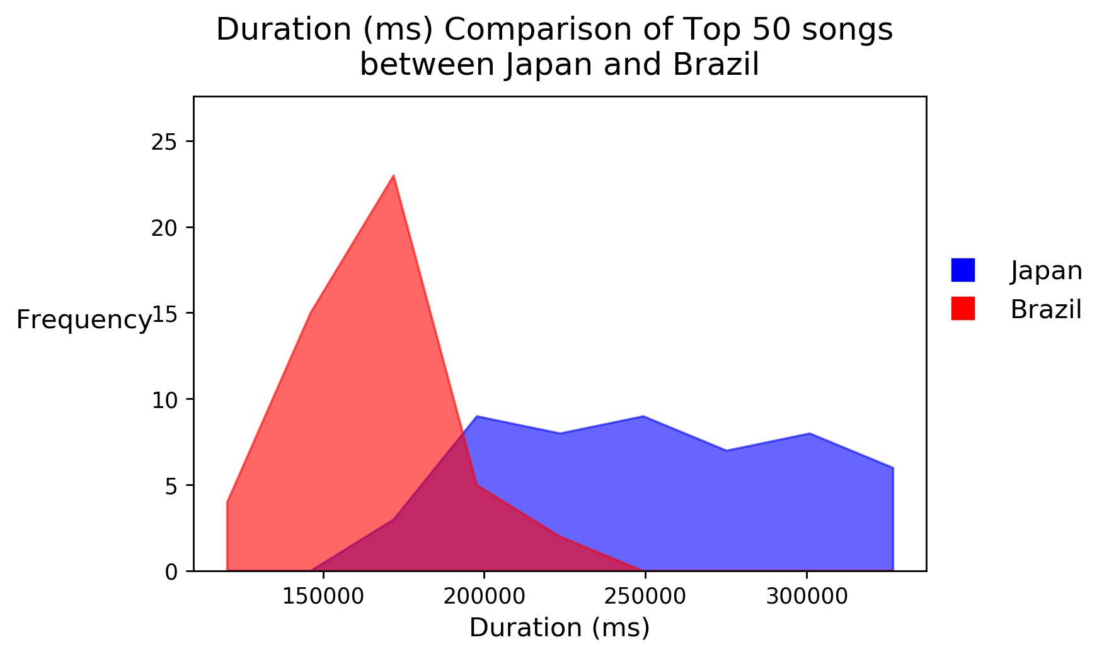
Duration
Aidan
The duration of the track in milliseconds.

Slide 22
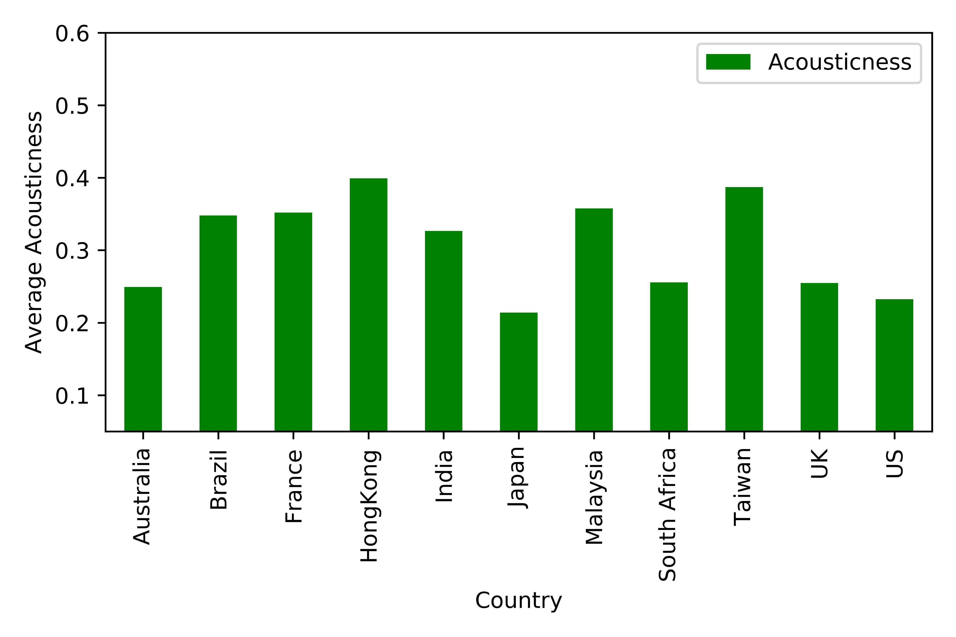
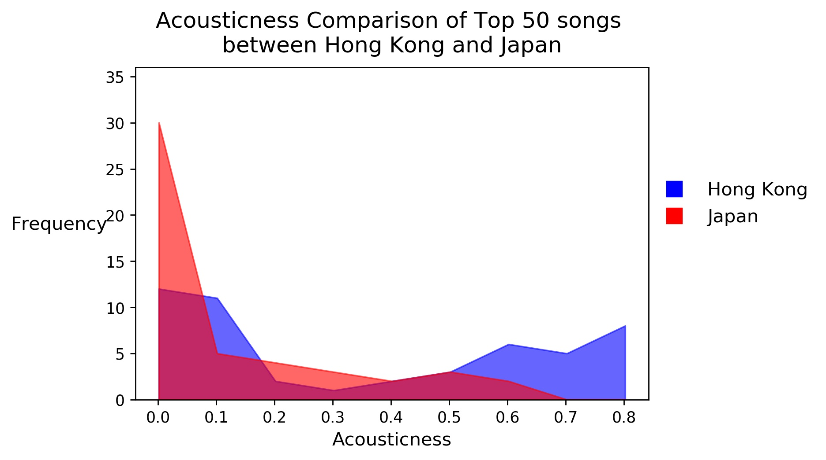
Acousticness
Aidan
A confidence measure from 0.0 to 1.0 of whether the track is acoustic. 1.0 represents high confidence the track is acoustic.

Slide 23
Code for Global
Ann Codes and Results in global

Slide 24
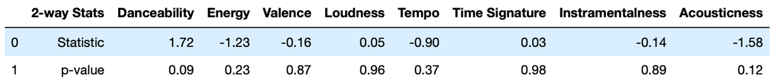
Global Chart vs. Country Charts (11 Countries studied)
Ann Codes and Results in global

Slide 25
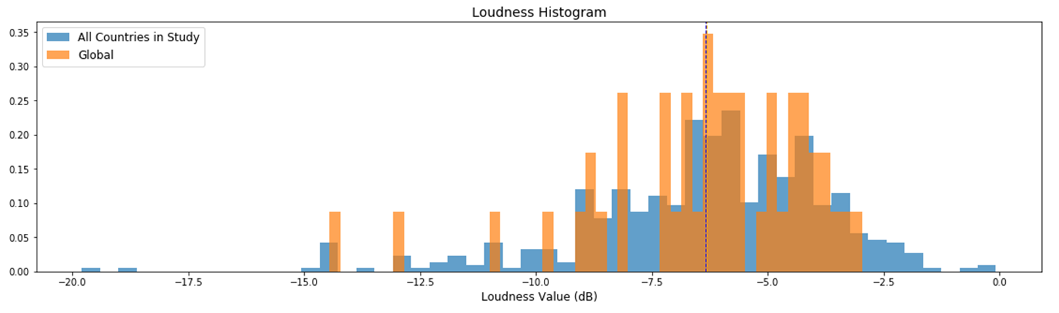
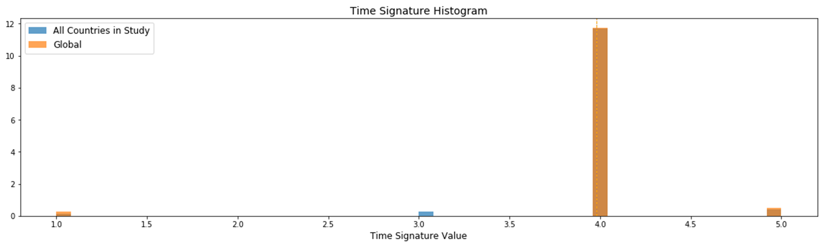
Ann Codes and Results in global

Slide 26
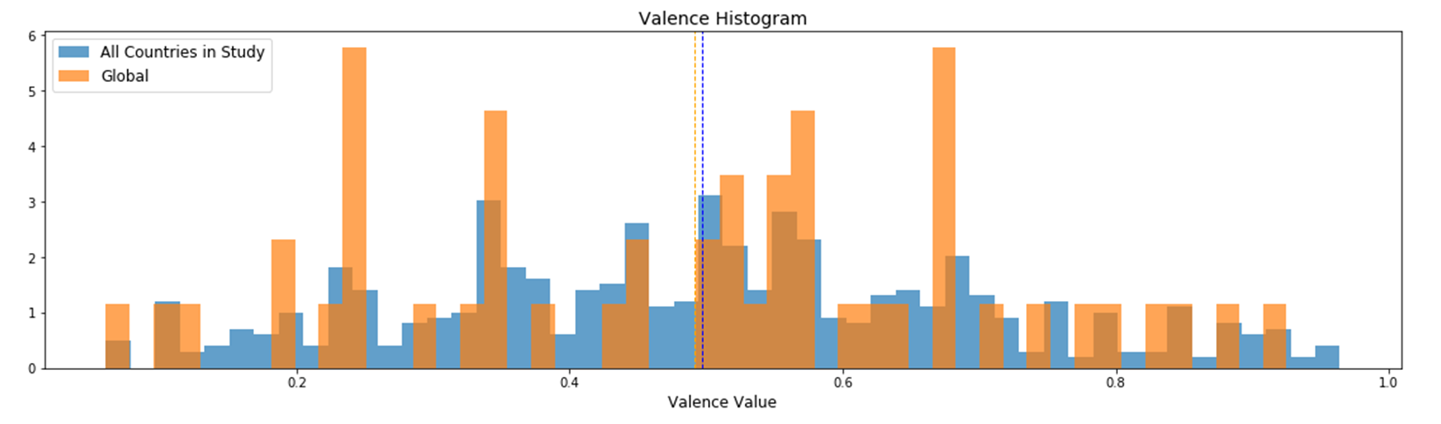
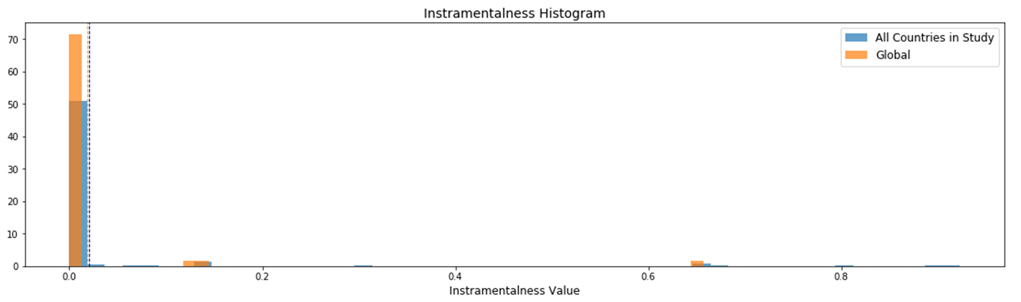
Ann Codes and Results in global

Slide 27
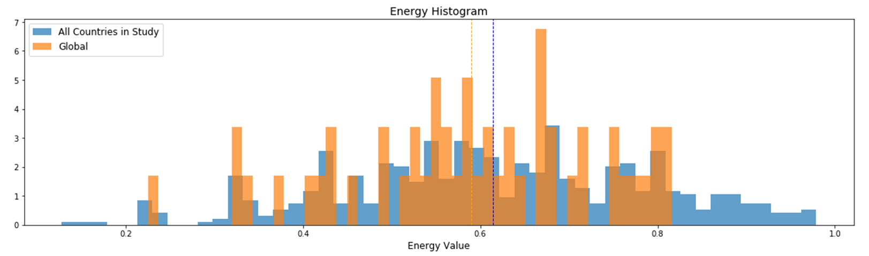
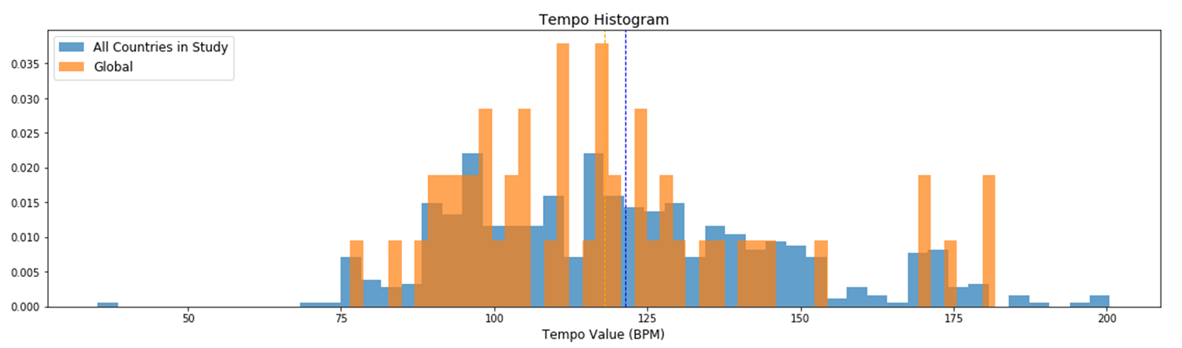
code
Ann Codes and Results in global

Slide 28
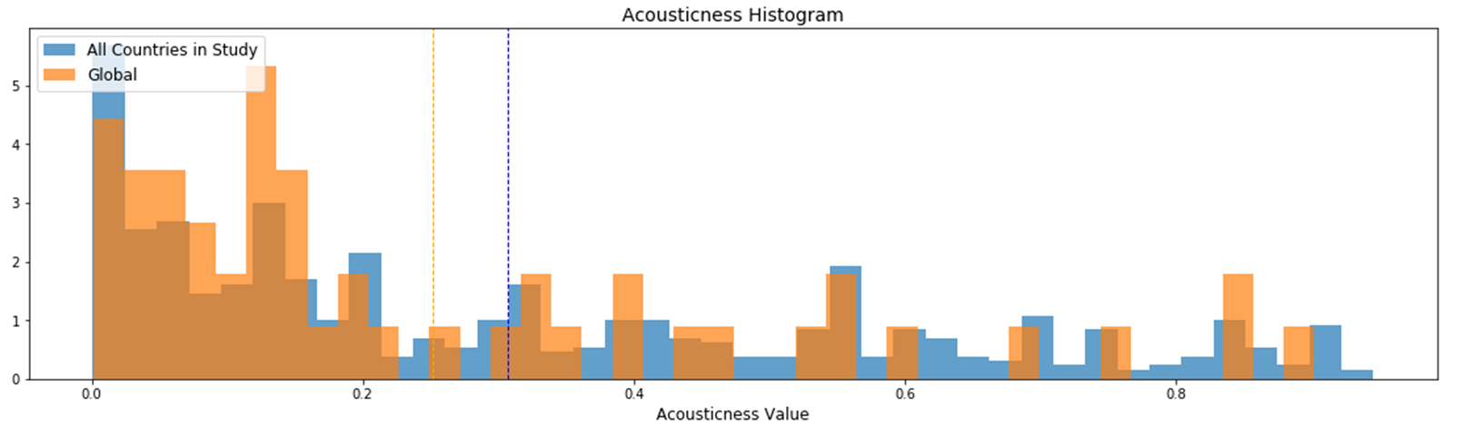
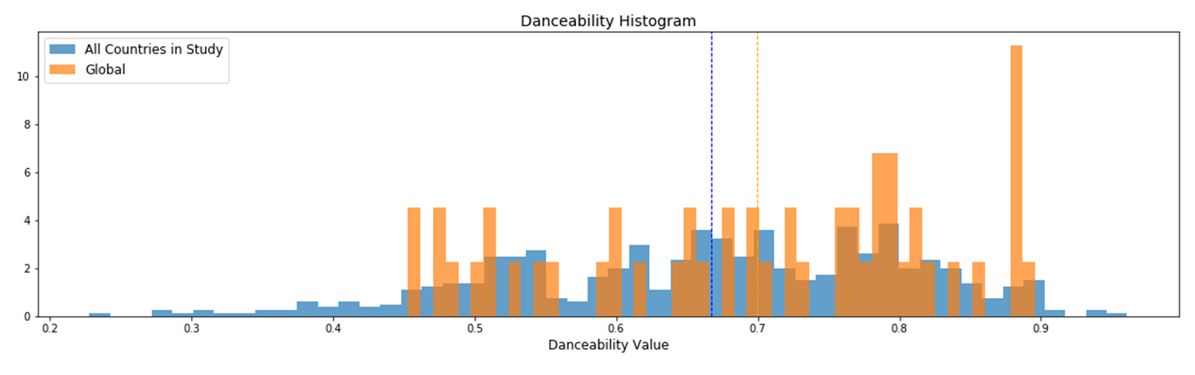
code
Ann Codes and Results in global

Slide 29
ANALYSIS LIMITATIONS
Amos
Songs are only from a top 50 playlists
Each song in top 50 is weighed equally
Possible to miss the impact of a single viral song
Spotify only vaguely explains how some audio features are calculated
No access to confidence values

